Slide 1
4COSCO11C.2 Web Design and Development
Introduction Web Technologies and HTML, CSS & Colors
Week 1

Slide 2
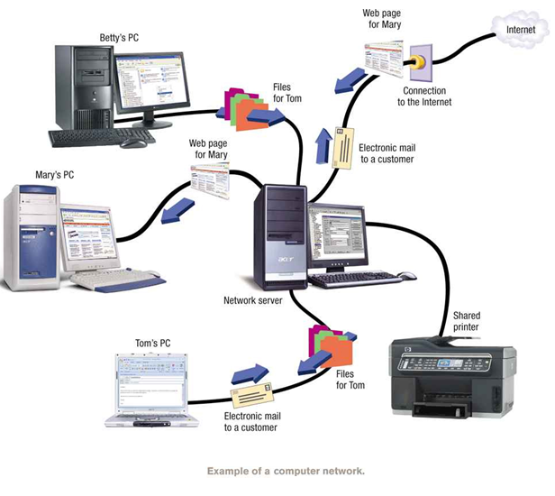
Computer Network
A computer network is a group of computers and other computing hardware devices that are linked together through communication channels to facilitate communication and resource-sharing among a wide range of users.

Slide 3
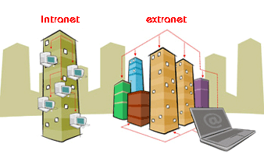
Types Of Networks
Intranet
A private computer network
Information is securely transferred among group of people
(E.g.: Share organizational information among employees)
Extranet
Same as Intranet but,
Share part of internal information or operations with outsiders
(E.g.: Share part of organizational information with vendors, suppliers…etc)
http://education-portal.com/academy/lesson/intranet-and-extranet-comparing-information-and-data-dissemination.html#lesson
Internet ?
Notes:
IIT has it own intranet – HR systems

Slide 4
Internet Communication
Protocols
Addressing
IP Address
Domain Name
URL

Slide 5
Protocol
There are rules governing how data is transferred over networks, how they are compressed, how they are presented on the screen and so on.
These set of rules are called protocols.
Examples :
HTTP - Hypertext Transfer Protocol
HTTPS - Secure Hypertext Transfer Protocol
TCP/IP – Transmission Control Protocol / Internet Protocol
FTP – File Transfer Protocol

Slide 6
Internet Addressing
An Internet Protocol address (also known as an IP address) is a numerical label assigned to each device (e.g., computer, printer) participating in a computer network
Every computer / device connected to the Internet has a unique identity.
You can use any of the following two ways:
(IP) address
a four-part number string
Example
192.168.0.128
domain name
a text
Example
abc.iit.lk
Notes:
To send data through internet -> you need to have an address

Slide 7
IP Address
Every machine on network has a unique identifying number, called an IP Address.
A typical IP address looks like this(ipv4): 216.27.61.137
The format of an IP address is a 32-bit numeric address written as four numbers separated by periods
Notes:
The Internet has run out of Internet addresses... sort of. Perhaps you've heard the news: the last blocks of IPv4 Internet addresses have been allocated.
The transition from IPv4 to IPv6 is likely to be rough, though. Most people are unfamiliar with IPv4 and IPv6, much less the potential impact the switch to IPv6 may have on their lives.
IP – interner protocol

Slide 8
Domain Names
A name that identifies a computer or computers on the Internet.
Advantage:
Numeric addresses are difficult to work with
Extremely difficult to remember as humans
Example
http://10.0.7.200:8080 Vs. https://soc.iit.ac.lk/
Disadvantage:
Unable to generate meaningful and unique names for all devices in the Internet

Slide 9
Levels of Domain
Domain names are organized in a hierarchical manner.
Top Level Domain (TLD) : Last part of the Domain name
e.g. : org is TLD of www.wikipedia.org
Second Level Domain: Name directly to the left of TLD
e.g. : wikipedia is SLD of www.wikipedia.org
Third Level Domain: Name directly to the left of second level Domain
e.g. : mail is SLD of mail.google.com
Notes:
Organizational Hierarchy
Domain Purpose
com Commercial organizations
edu Educational institutions
gov Government institutions
mil Military groups
net Major network support centers
org Nonprofit organizations and others
int International organizations
Geographic hierarchy
In the geographic hierarchy, each country is assigned with two letter codes. These codes are used to identify countries.
For example, take the domain name images.google.com
Here, the “.com” is the top-level domain. It is called as tld in short. This is the next component in the DNS hierarchy. A TLD can have many domains under it. For example, a .com tld can have linux.com, centos.com, ubuntu.com, etc.
Sometimes, there is a second level hierarchy to a tld. They deal with the type of entity intended to register an SLD under it. For example, for the .uk tld, a college or other academic institution would register under the .ac.uk ccSLD, while companies would register under .co.uk.

Slide 10
Domain Name System
Domain Name System (DNS) is a database system that translates a computer's fully qualified domain name into an IP address.
www.amazon.com
207.171.166.48
DNS Resolution

Slide 11
DNS resolution
Translating the name into the IP address is called “resolving the domain name” or “DNS resolution”.
Resolution occurs when a client queries a name server to obtain the IP address with which it wants to connect.
If a name server in the local domain cannot resolve a client's request, it queries other servers to locate a server that can.

Slide 12
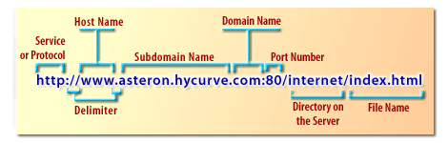
Uniform Resource Locator
URL is the unique address for a file that is accessible on the Internet.
http://www.seopearl.com/internet-web-technologies/module4/uniform-resource-locator.php
Notes:
URI stands for uniform resource identifier and URL stands for uniform resource locator.
URLs are a subset of URIs. That means all URLs are URIs. It doesn't work the opposite way though.

Slide 13
Web Browsers
Software application for retrieving, presenting, and traversing information resources on the World Wide Web.
Information Resources : Images, videos, and other piece of content. Hyperlinks present in resources enable users to easily navigate their browsers to related resources.
URL : (Uniform Resources Locaters) are used to identify the location of the resources in the Internet.

Slide 14
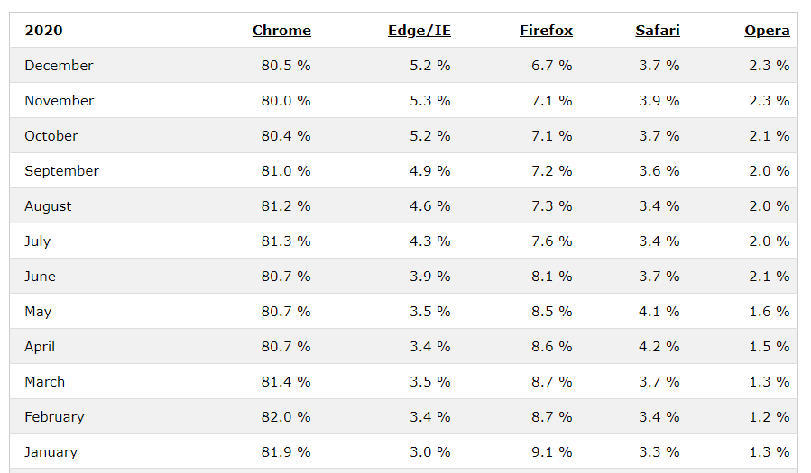
Web Browsers
Read more:
http://www.w3schools.com/browsers/default.asp
http://www.smashingmagazine.com/2007/11/21/web-browsers-you-have-never-heard-of/

Slide 15

Web Servers
A web Server: computers on the Internet that host websites, serving pages to viewers upon request.
Each Web server has a unique address (IP address) and domain name and Provide services such as Web hosting
Read More:
Comparison of web servers
http://en.wikipedia.org/wiki/Comparison_of_web_servers

Slide 16
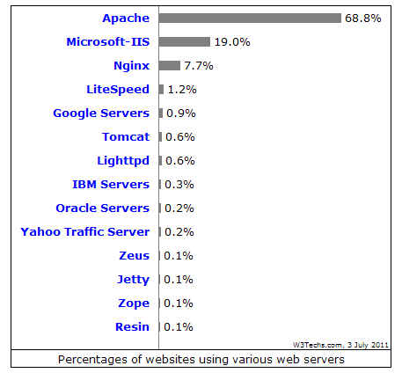



Web Servers
16
Any computer can be turned into a Web server by installing server software and connecting the machine to the Internet
IIS
http://www.iis.net/
Apache
http://www.apache.org/
Tomcat
http://tomcat.apache.org/
Glassfish
https://glassfish.dev.java.net/

Slide 17
Introduction to HTML
HTML (HyperText Markup Language) is a markup language which consists of tags embedded in the text of a document.
The browser reading the document interprets these markup tags to help format the document for subsequent display to a reader.
The browser displays the document with regard to features that the viewer selects either explicitly or implicitly. Factors affecting the layout and presentation include:
The markup tags used.
The physical page width.
The fonts used to display the text.
The colour depth of the display.

Slide 18
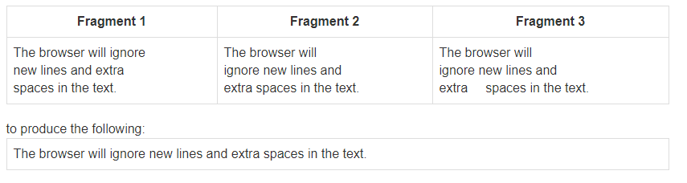
Contd..
The browser, ignores extra spaces and new lines between words and markup tags when reading the document.
Thus, the following three text fragments will be formatted identically.

Slide 19
History of HTML
1991
HTML first published
1995
HTML 2.0
After HTML 4.01 was released, focus shifted to XHTML and its stricter standards.
1997
HTML 3.2
1999
HTML 4.01
XHTML 2.0 had even stricter standards than 1.0, rejecting web pages that did not comply. It fell out of favor gradually and was abandoned completely in 2009.
2000
XHTML 1.0
2002 -2009
HTML5 is much more tolerant and can handle markup from all the prior versions.
XHTML 2.0
HTML5
Though HTML5 was published officially in 2012, it has been in development since 2004.
2012
Notes:
XHTML is HTML written as XML.
What Is XHTML?
XHTML stands for EXtensible HyperText Markup Language

Slide 20
HTML5?
HTML5 is the newest version of HTML.
Support all existing web pages. With HTML5, there is no requirement to go back and revise older websites.
Reduce the need for external plugins and scripts to show website content.
Improve the semantic definition (i.e. meaning and purpose) of page elements.
Make the rendering of web content universal and independent of the device being used.
Handle web documents errors in a better and more consistent fashion.

Slide 21
Structure of the HTML page
The html content then begins with the tag <html> and ends with the tag </html>. The document is the divided into two sections:
the head, bracketed by <head> and </head>
the body, bracketed by <body> and </body>
The head of an HTML document contains identifying and control information that is not part of the displayed text. Such information can be the document title, bracketed by the <title> and <title> tags.
The body of the document is where the user-readable text is stored and usually accounts for the bulk of the document.
Various control tags are there to tell the browser where to insert line breaks and how to format the document.

Slide 22
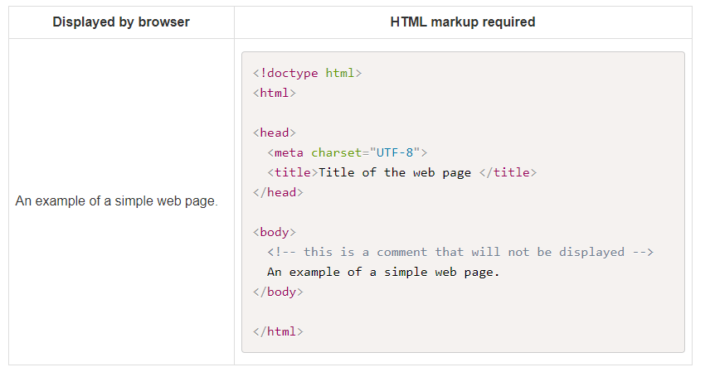
Sample HTML Page

Slide 23
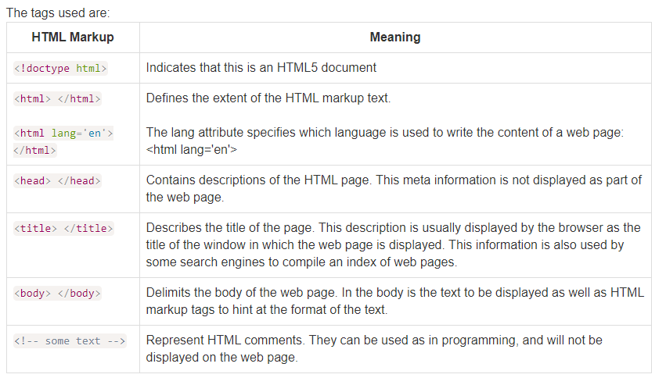
Tags used

Slide 24
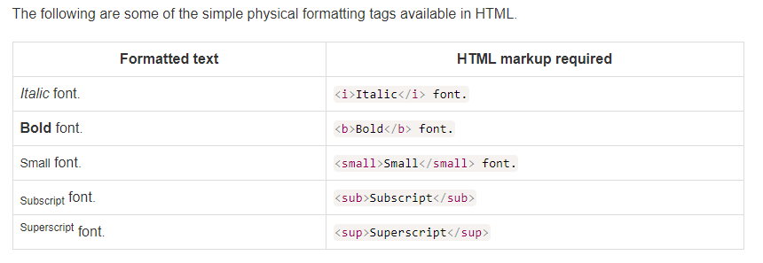
Simple Formatting Tags

Slide 25
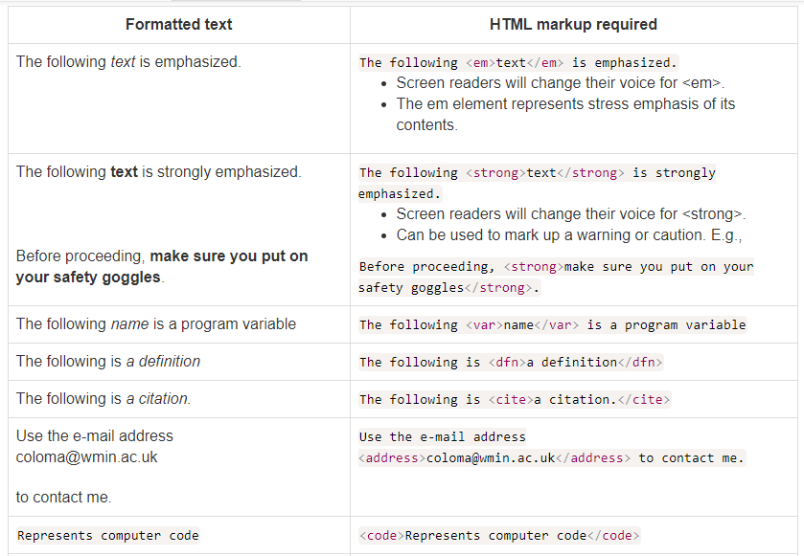
Logical Formatting Tags
These should be used to describe a logical unit of your document.

Slide 26
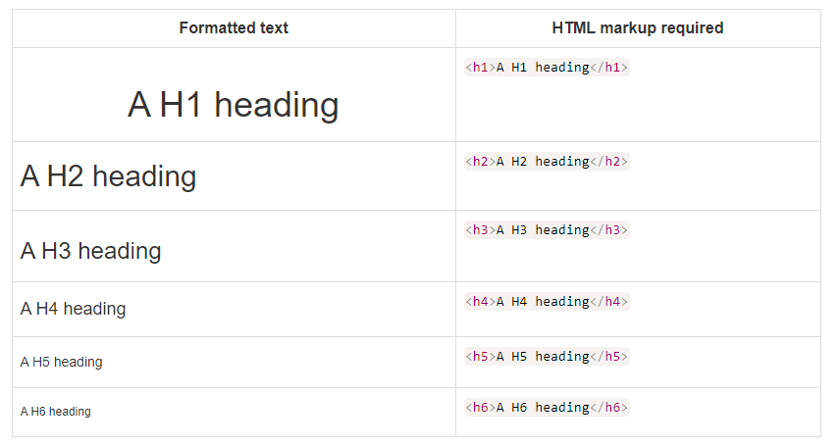
Headings
A heading in the text is created with the <h1> tag. There are in fact six heading tags, going from <h1> the largest to <h6> the smallest.

Slide 27
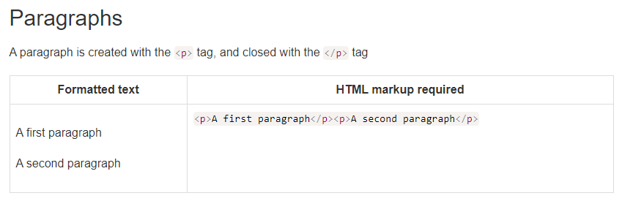
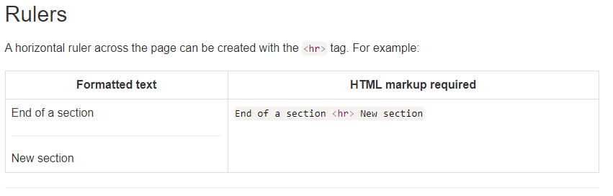
Paragraphs/Rulers

Slide 28
Styling & CSS
CSS Syntax
CSS works with HTML to define the way content is presented.
Styles can be specified:
in the head of a HTML document - embedded style sheet;
in a separate style sheet - external style sheet;
directly into individual HTML elements - inline styles.

Slide 29
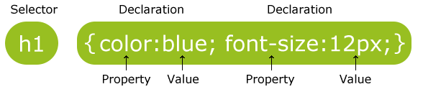
CSS Syntax
A CSS rule set consists of a selector and a declaration block:
The selector points to the HTML element you want to style.
The declaration block contains one or more declarations separated by semicolons.
Each declaration includes a property name and a value, separated by a colon.
29

Slide 30
Ways of inserting a style sheet
When a browser reads a style sheet, it will format the document according to the information in the style sheet.
There are three ways of inserting a style sheet:
Inline style
Embedded style sheet
External style sheet

Slide 31
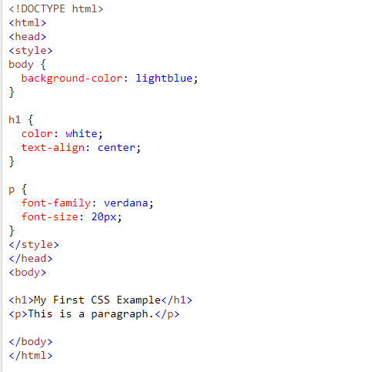

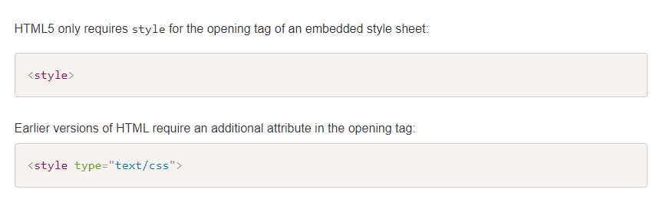
Embedded Style Sheet
Note that this method is used for styles that are to be applied to a single HTML document.

Slide 32
External Style Sheet
An external style sheet is a separate text file containing all your CSS rules.
Note that the text file does not contain the <style> tag and you need to end the file name with the extension .css.
The style sheet can be applied to any number of HTML files.
When you make a change to an external style sheet, all the pages that reference it are automatically updated as well.

Slide 33
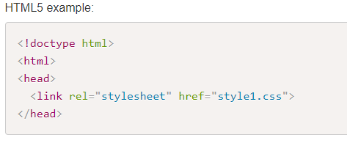
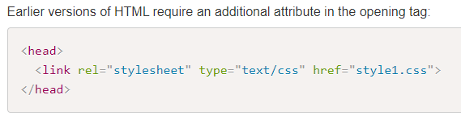

External Style Sheet Example
Content of the text file which contains styles will be without the <style> as below

Slide 34
Inline Styles
It only applies to the element that contains the inline style. This method can also be used to override any previously declared styles. For example:
Inline styles are good for testing. However, inline styles are rarely used for final versions of a website. Why?
Notes:
Inline style Sheets are difficult to modify
Solution is an Internal style Sheet
An internal style sheet should be used when a single document has a unique style.
You define internal styles in the head section of an HTML page, inside the <style> tag, like this:

Slide 35
Lots of CSS properties to play with
background-color, border-width, border-color, margin-top, padding, font-family, top, left, right, float, font-size, background-image, text-align, text-decoration, font-style, font-weight, vertical-align, visibility, overflow, ....

Slide 36

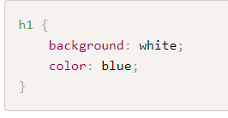
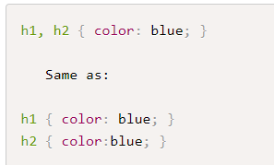
CSS Selectors
1.Selecting elements by name:
2.To add additional rules use semi-colon:
3. Selecting groups of elements. Note group selectors are separated by a comma:

Slide 37
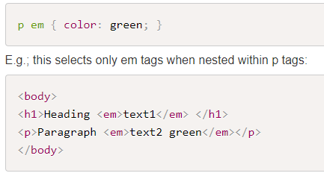
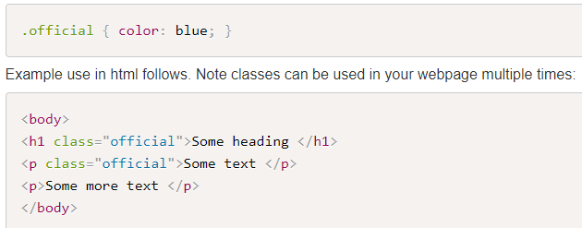
CSS Selectors
4.Selecting elements by context (descendant selector) to select a tag that is nested inside another specified tag.
Note contextual selectors are separated by whitespace:
5. Selecting elements by class. When you want to give one or more elements a style that is different to related tags on a web page:

Slide 38
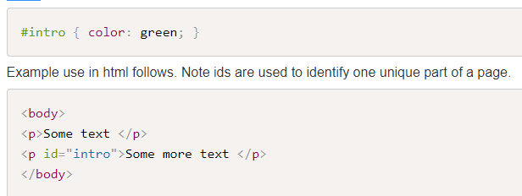
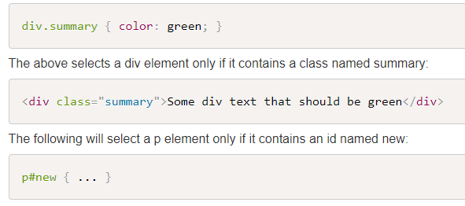
CSS Selectors
6. Selecting elements by id. When you want to give one element a style that is different to related tags on a web page:
7. Combining selectors.

Slide 39


CSS Selectors
8. Universal selector - targets all elements on the page.
9. Link pseudo-classes: selecting elements based on their state (see next section):

Slide 40
Span and Div Elements
<span> element is a grouping element. Its primary purpose is to apply CSS rules or id attributes to a block of text. It is an in-line level element, which means it is displayed in line with other text and with no line breaks.
<div> is a similar element but displayed on its own line, with margins above and below. It is a block-level element

Slide 41


Review Questions
What tag is used to embed a style sheet?
What tag is used to link to an external style sheet?
How do you define and use a CSS class?
How do you define and use a CSS id?
What is the difference between:
What would the following select?

Slide 42
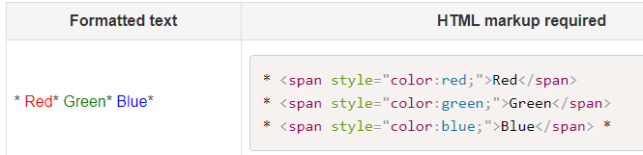
Colours
In HTML, it is possible to specify a colour by using its name or RGB value using a decimal or Hex value.
Specifying a colour by name
In HMTL5, you will use CSS to change the colour of various elements. You can for example change the text colour by adding inline styles: <style="color:red">

Slide 43
Specifying Color by value
The format of an RGB value in hexadecimal notation is a # immediately followed by either three or six hexadecimal characters.
A general colour is specified in terms of the three primary colours red, blue and green.
Each primary colour is defined as a one or two digit Hexadecimal number that representing the strength of that primary colour.
The three-digit RGB notation (#rgb) is converted into six-digit form (#rrggbb) by replicating digits, not by adding zeros.
For example, #fb0 expands to #ffbb00, and #fff expands to #ffffff
In this specification hexadecimal 00 means 0% of the colour and hexadecimal ff means 100% of the colour.

Slide 44
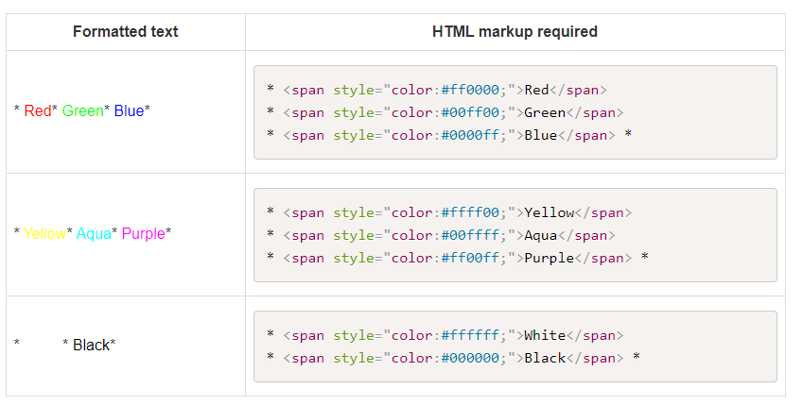
Contd
The first two digits after the # symbol ff define 100% of red
The second two digits after the # symbol 00 define 0% of green
The third two digits after the # symbol 00 define 0% of blue
Note that you could also use the three-digit form #f00 to specify the red colour.

Slide 45
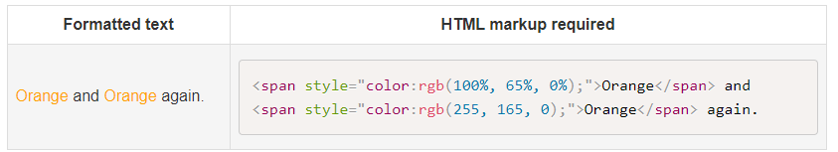
Functional RGB color values
The format of an RGB value in the functional notation is rgb( followed by a comma-separated list of three numerical values (either three integer values or three percentage values) followed by ).
The integer value 255 corresponds to 100%, and to F or FF in the hexadecimal notation: rgb(255,255,255) = rgb(100%,100%,100%) = #FFF = #FFFFFF.
White space characters are allowed around the numerical values.

Slide 46
Review Questions
Question 1 - What is the colour code for a light blue in RGB using hexademical notation?
Question 2 - What is the colour code for a light blue in RGB using functional notation?
Question 3 - What is the colour code for a very transparent dark blue?
Question 4 - What colour is #000080?
Question 5 - Is #000080 exactly identical to #008?
Question 6 - What is the six-digit hexadecimal colour code for #369?

